Slide 1
Computer Architecture Concepts
Part 24 – Branch instructions

Slide 2
Objectives
We have already seen jump instructions to change the flow of a program
jal label
ret
These allowed us to pass the program control to a subroutine
Now we will look at other instructions for changing program flow – branch instructions (still using labels)

Slide 3
Branching
Allows conditional changes in execution path
Then we can code if/else type statements and loops
Based on some condition we either continue on the code path or move to a different part of the program
There are many different variations of branch instructions in RISC-V basic and pseudo-instructions. We will only look at a few of them.

Slide 4
Example branch instructions in RISC-V
Basic instructions
Branch if the value in the first register is greater than or equal to the second
bge, register1, register2, label
Pseudo instructions
Branch always
b, label
Branch not equal to zero
bnez, register, label
Notes:
Note there are many more

Slide 5
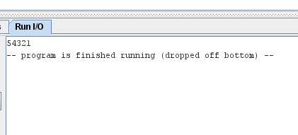
Creating a countdown loop
addi a0, zero, 5
addi a7, zero, 1
loop:
ecall
addi a0, a0, -1
bnez a0, loop

Slide 6
Making decisions
Suppose we want the user to input their mark and the program will tell them if it’s a pass or a fail
Compare the mark to 40
Store 40 in a register (I’ll use t0)
Assume that the user inputs an integer in the correct range (0 to 100)

Slide 7
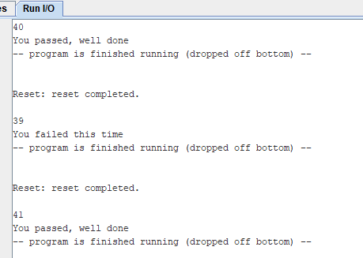
Pass or fail
.data
msgPass: .string "You passed, well done"
msgFail: .string "You failed this time"
.text
addi a7, zero, 5
ecall
addi t0, zero, 40
bge a0, t0, pass
la a0, msgFail
b output
pass:
la a0, msgPass
output:
addi a7, zero, 4
ecall
This is only one approach
Other branch instructions could have been used
Receive integer input from the user and store in register a0
Store 40 in register t0
If a0 is greater than or equal to t0, go to pass
These lines run if we didn’t branch to pass
We need to skip the load of the pass message

Slide 8
Summary
We have had a brief look at some of the branch instructions available in RISC-V assembly language

